Slide 2
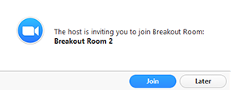
How to join a Zoom Breakout Room

