Slide 1
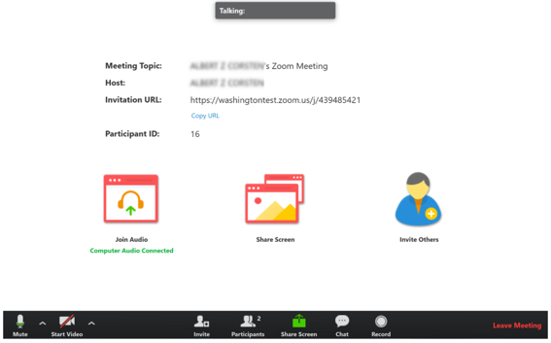
Welcome!
If you are new to using Zoom, please follow the instructions on this screen before the session begins.
Once you have checked your microphone and know it works, please stay muted unless in use.
If you experience technical difficulties, log out and back in.
1.
2.
3.
1. Test your webcam and mic by clicking the up arrow near the Mute button.
2. Locate the Participants button and practice the raise hand option.
3. Locate the chat button (and say hello!)

Slide 2
Housekeeping
This session is being recorded. Recording will be available in location approximately N hours after class.
Please keep your mic muted. You are welcome to use/not use your webcam in this room, but are encouraged to turn it on in breakout rooms.
If you have a question, please call it out, raise your hand (virtually), or post it in the chat.
There will be a 10-minute break close to the end of each scheduled class hour, but please take one as needed.

