Slide 1

Online Dispute Resolution (ODR)
Moving from in-class to on-line dispute management
May 2020
Recommended reference: Conestoga College (2020). Online Dispute Resolution [PowerPoint]. Prepared by MIchael Quartermain. CC-BY-NC-SA
Photo by Austin Distel on Unsplash

Slide 2
Overview
Disputes are inevitable at the best of times in class and group situations (personal and professional).
In the new online reality of course delivery, managing disputes creates new challenges for Instructors.
There is a common ground for students – passing the course – as an Instructor how do you facilitate this?
Managing conflict is a skill – a learning opportunity for students to carry forward into their personal and professional life.

Slide 3

Guiding Principles
Openness – different views and opinions
Accessibility – necessary tools and support
Power balancing – level playing field; equal voice
Equitable – fairness
Student Centered – recognizing needs of students
Respect – of diversity and mutual reciprocation
Image by Gerd Altmann from Pixabay

Slide 4
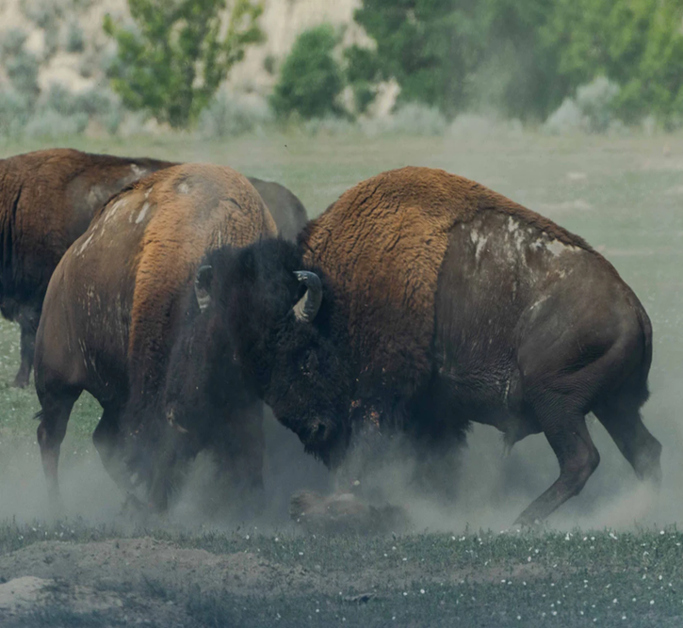
Key Points
Disputes are inevitable.
Disputes can be a constructive learning opportunity for students.
Disputes needs to be actively managed.
A need to ensure delivery of the course promise, performance outcomes and student potential – student centered.
Photo by Richard Lee on Unsplash

Slide 5

Changes & Challenges
Lose contextual ques:
  body language; facial expressions; general warmth
Slower pace
  coordinating speaking; maintaining momentum of discussion
Technical
  Connections; delay due to coordination; response
Changes content background and information
  Uncovering details – less obvious information
Photo by Headway on Unsplash

Slide 6
Benefits
Convenience – anytime anywhere;
Can level the playing field of different student personalities ( e.g. introvert vs. extravert);
Can be a lower stress environment (versus face to face);
Ability to record discussion and outcomes live – real time
  (also a risk that others record the discussions);
Tracking and tracing electronic communications flow and exchanges, supporting documentation.

Slide 7
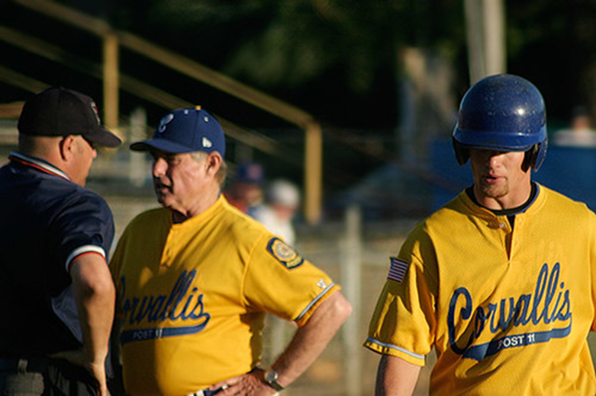
Types of group disputes
Contributions:
  Unequal participation – not completing their part of assigned group work – quality of contributions
Coordination:
  Balancing group meeting times; class time; work time; personal time
Communication:
  Language (English; dialectics); decoding messages; sending messages
"Dispute" by ap. is licensed under CC BY-NC 2.0

Slide 8

Resolving Disputes
Leverage the trust and confidence built as an Instructor
Actively manage and monitor a dispute
Be clear on individual and group expectations - establish shared goals
Remember:
You will now see your face and facial expressions online!
Image by Gerd Altmann from Pixabay

Slide 9

Resolving Disputes
Balance empathy (without agreeing) – with problem solving – the need to be directive
Be genuine – be open to different perspectives
Practice active listening skills
Remember:
You can be recorded!
Image by Gerd Altmann from Pixabay

Slide 10

Questions to ask yourself
What is the dispute about and who is involved?
Is this something that can be worked out by the students involved in the dispute – use indirect coaching of students?
Is the issue important enough to actively pursue – direct involvement by the Instructor or other college resources?
How will or what will benefit the student (student centered) direct or indirect involvement?
Is there are risk of physical, mental or emotional abuse (bullying)?
Do I have all the information I need about the situation, what are the resources available to me, and college policies in place?
Adapted from Working together: a guide to positive problem solving for schools, families, and communities (2014)
Image sourcehttps://www.christinewilke.com/marriageblog/2017/5/2/want-a-happier-marriage-ask-yourself-this-question-everyday

Slide 11
Process
Working together: a guide to positive problem solving for schools, families, and communities (2014)

Slide 12
Approaches – Getting to Yes
(Fisher, Ury, Patton, 1991)
Do not make it personal – separate people & problems
  Interests and values can get intertwined (Lyons, 2007)
Focus on interests, not positions
  What are the interests behind individual positions – what is a common interest (passing the course?)
Invent options for mutual gain
  Solutions driven by group – (be prepared to be directive if necessary)
Insist on using objective criteria
  Rely on course rubric, course outlines as objective criteria – sets expectations
Know your alternatives as an Instructor
  Sometimes referred to as Best Alternative to a Negotiated Agreement (BATNA)

Slide 13
Approaches - (GRIT)
(Osgood,1967)
Graduated and Reciprocated Initiatives in Tension reduction (GRIT)
A conflict de-escalation method encouraging concessions by each side
Small concessions that are reciprocated to propel discussion towards a common understanding between team members

Slide 14









Platforms
Telephone, E-mail, Course Mail
Document sharing
Online – teleconference

Slide 15

Tools & Tips
Consider including or using:
An overview of team work and conflict resolution – build skill set
  (support of Teaching & Learning)
Team contracts
Team status reports (weekly; bi-weekly)
Team check in meetings
Peer Evaluations
Directive – assignment of specific deliverables
Reassigning group members
Image source: https://www.clipartkey.com/view/iRmwiRT_external-tips-icon-transparent-background/​

Slide 16
Resources
Faculty Learning Hub
https://tlconestoga.ca/remote-group-conflict/
Student Rights & Responsibilities
https://www.conestogac.on.ca/student-rights/responsibilities

Slide 17
Communication - Sample
Online communications may include
statements that they may not normally
say during a face-to-face interaction

Slide 18
Directive – Sample
BUS1234_Section 5 Group A Work Plan
THIS IS THE WORK TO BE COMPLETED BY EACH INDIVIDUAL TO GET TO THE END OF THE TERM
> work is to be of good quality and submitted in a timely manner for Person A to combine and submit
> the due dates are indicated due to Person A so there is time for him/her to combine your individual work
> if an individual does not complete their assigned piece of work on time to Person A he/she will submit without the work
Team Member | Work Assigned
 | Deliverable 1 | Deliverable 2 | Deliverable 3 | Deliverable 4
Person A | compile & submit | part 1 | part 3 | part 2
Person B | part 1 | compile & submit | part 2 | part 3
Person C | part 2 | part 3 | compile & submit | part 1
Person D | part 3 | part 2 | part 1 | compile & submit
DUE DATE TO | April 2nd | April 7th | April 14th | April 21st
Person A
Submission Due Date | April 3rd | April 8th | April 15th | April 22nd
A directive approach
could be used to speed
the conclusion of decision
making

Slide 19
Peer Evaluation – Sample (Excel)
PEER EVALUATION FORM
GROUP NUMBER | <enter here>
Evaluation Criteria | Accepted Tasks/work assigned | Supportive of other group members | Contributed quality work and ideas | Showed Initiative | Team Member contributed and equal amount of work | Attended & Participated in all team meetings | TOTAL RATING
YOUR NAME
Team Member Name
1) |  |  |  |  |  |  | 0
2) |  |  |  |  |  |  | 0
3) |  |  |  |  |  |  | 0
4) |  |  |  |  |  |  | 0
5) |  |  |  |  |  |  | 0
6) |  |  |  |  |  |  | 0
INSTRUCTIONS
After completing your group assignment, a peer evaluation will be completed by each group member to allocate marks for individual student contribution to the overall assignment. (Do not evaluate yourself).
Ranking Scale is 1 - 4:
1= Seldom - 2 = Sometimes 3= Most of the time 4 = Always

Slide 20
Peer Evaluation – Sample (Word)

Slide 21
Team Contract- Sample

Slide 22
Team Contract- Sample

Slide 23
Team Reporting - Sample

Slide 24
References
Citizenship and Youth, Minister of Education, Citizenship and Youth (2004). Working together: a guide to positive problem solving for schools, families and communities. Manitoba: Manitoba Crown Press.
Fisher, Roger; Ury, William; Patton, Bruce (1991). Getting to Yes:
Negotiating Agreement Without Giving In (2nd ed.). New York: Penguin Books.
Lyons, Carl (2007). I win, you win: the essential guide to principled negotiation. London: A & C Black
Osgood, C. E. (1962). An alternative to war or surrender. Urbana: University of Illinois Press.

